Slide 1
Powder Metallurgy Hot Isostatic Pressing: Titanium Done Differently for Defence
Gerry Clark Representing Proxima Powder Metallurgy (UK)

Slide 2
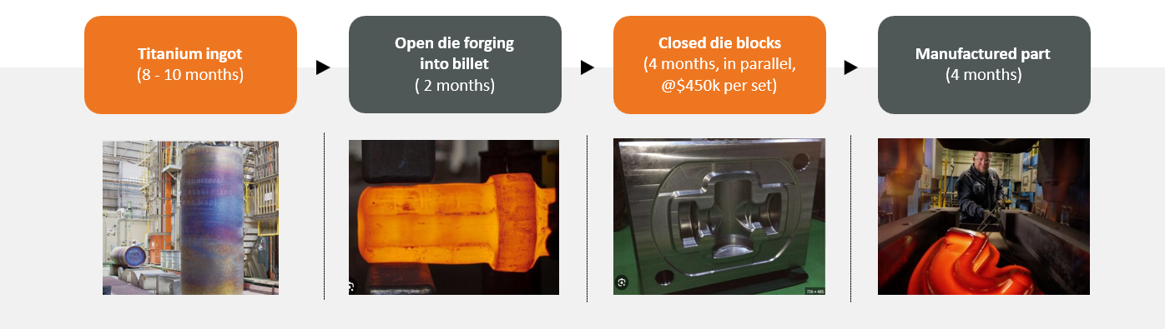
Forging or Casting Route – This is what you do today
Conventional forging of high-integrity parts is lengthy, inflexible and costly

Slide 3
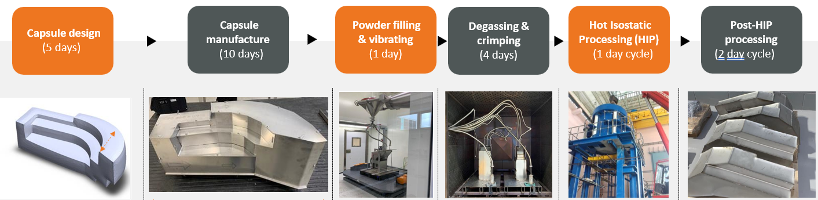
Proxima production supply chain offering – This is what we do today
The PM-HIP process is fast, efficient and highly flexible –
it reduces cost, reduces lead-time

Slide 4
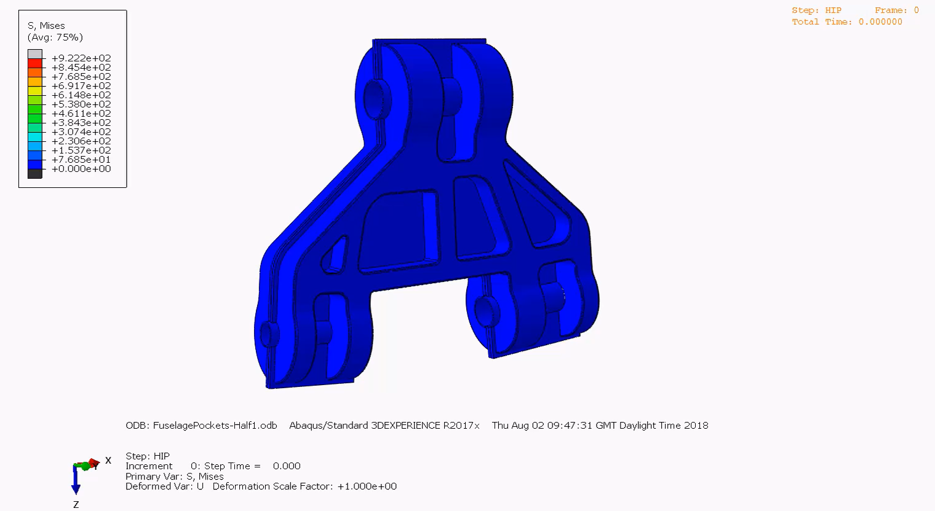
Designing a Capsule for PM-HIP
Request a model from the customer
Proxima takes this model and creates a ‘preform’ to ensure total clean up during the CNC machining stage
Proxima now simulates how the preform could change shape under the high pressure of Hot Isostatic Pressing
Proxima may have two or three virtual simulations, continually amending the preform until we have a good fit
Proxima builds the steel capsule around the exterior contours of the preform
Next stage is welding, leak test, bake-out & HIP

Slide 5
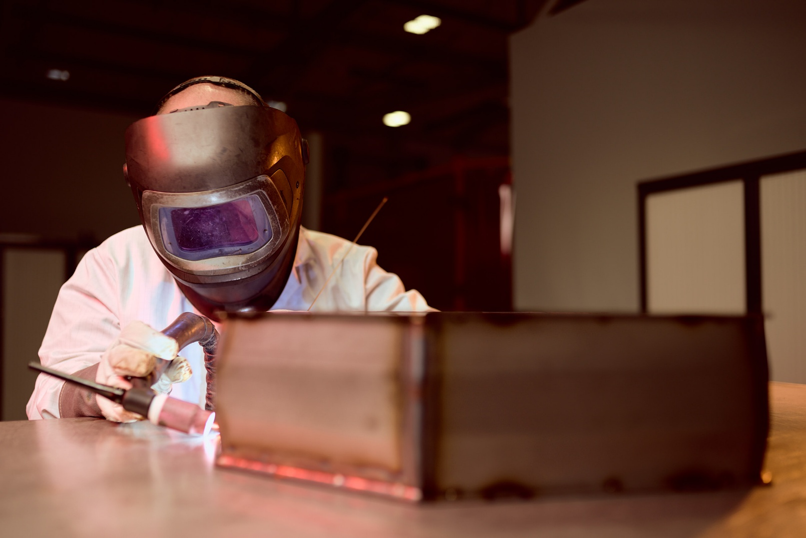
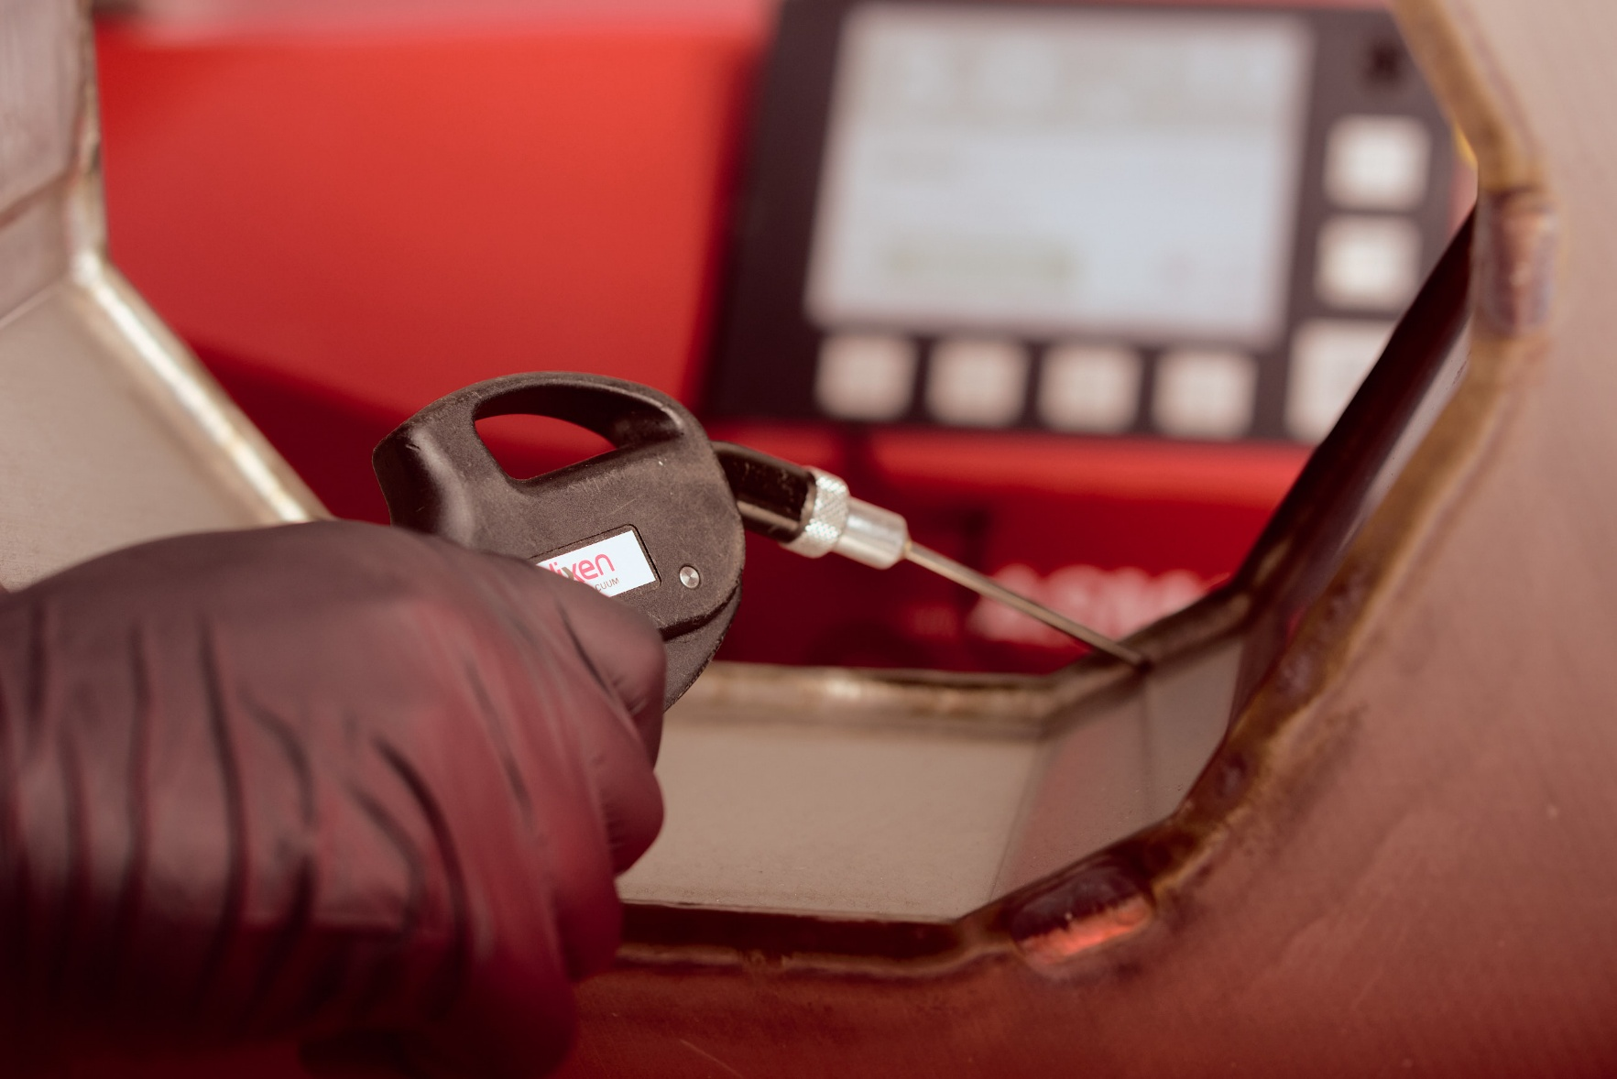
Encapsulation – Capsule Welding
TIG welding for guaranteed penetration – all welders are coded
Leak Check to ensure a gas tight capsule
Capsule now ready for powder filling

Slide 6
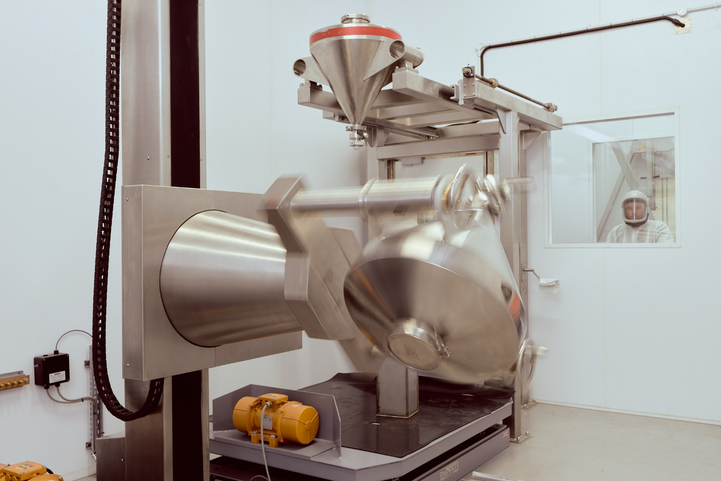
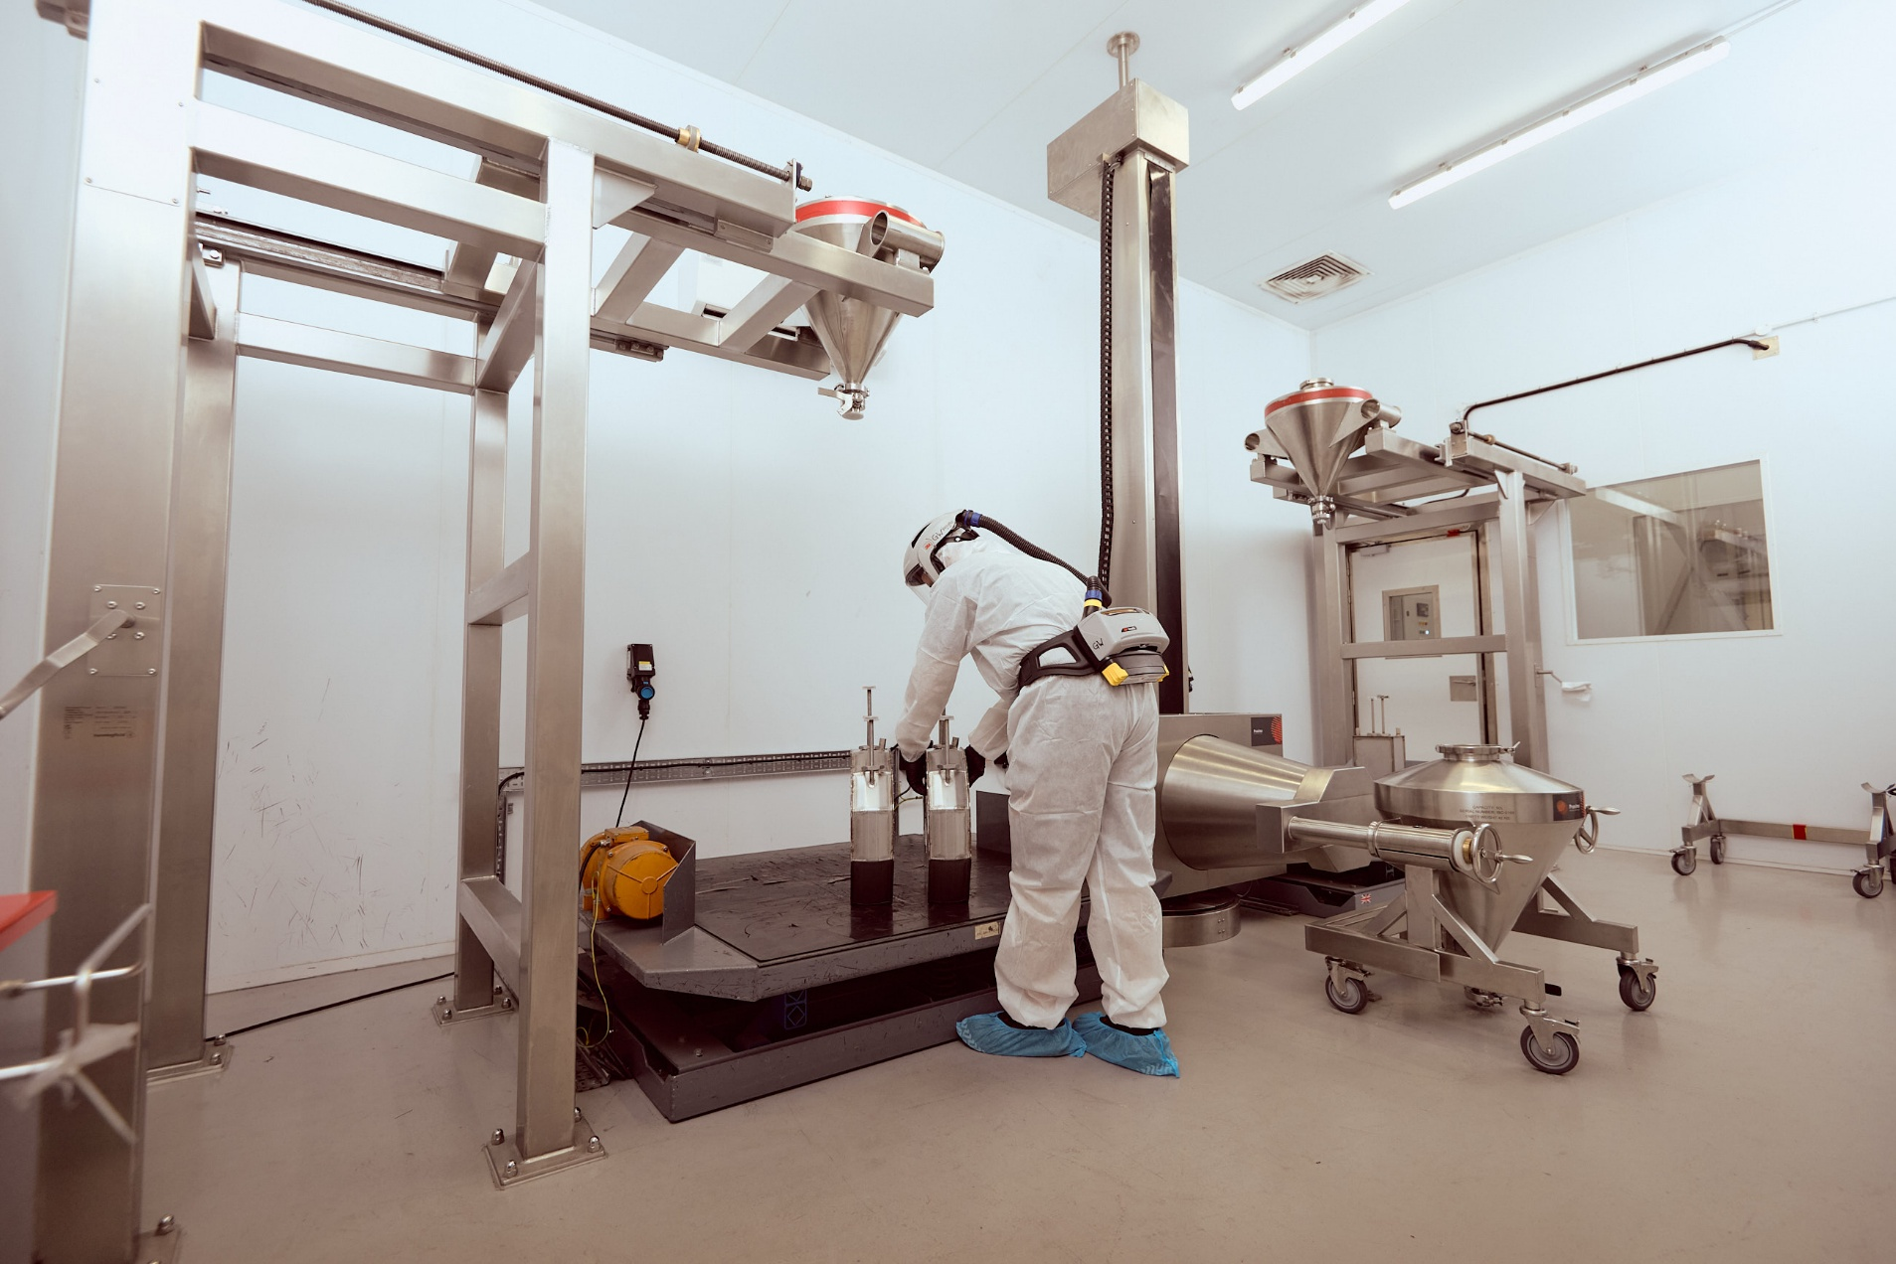
Encapsulation – Filling Stations
Correct powder (Powder size distribution) selected
Weight of powder is recorded before and after filling (minus the capsule weight)
Capsule now ready for powder filling
Vibration table with gravity flexible hoses connected to a hopper
ATEX rated rooms to reduce ignition risk from titanium powder – industry known risk

Slide 7
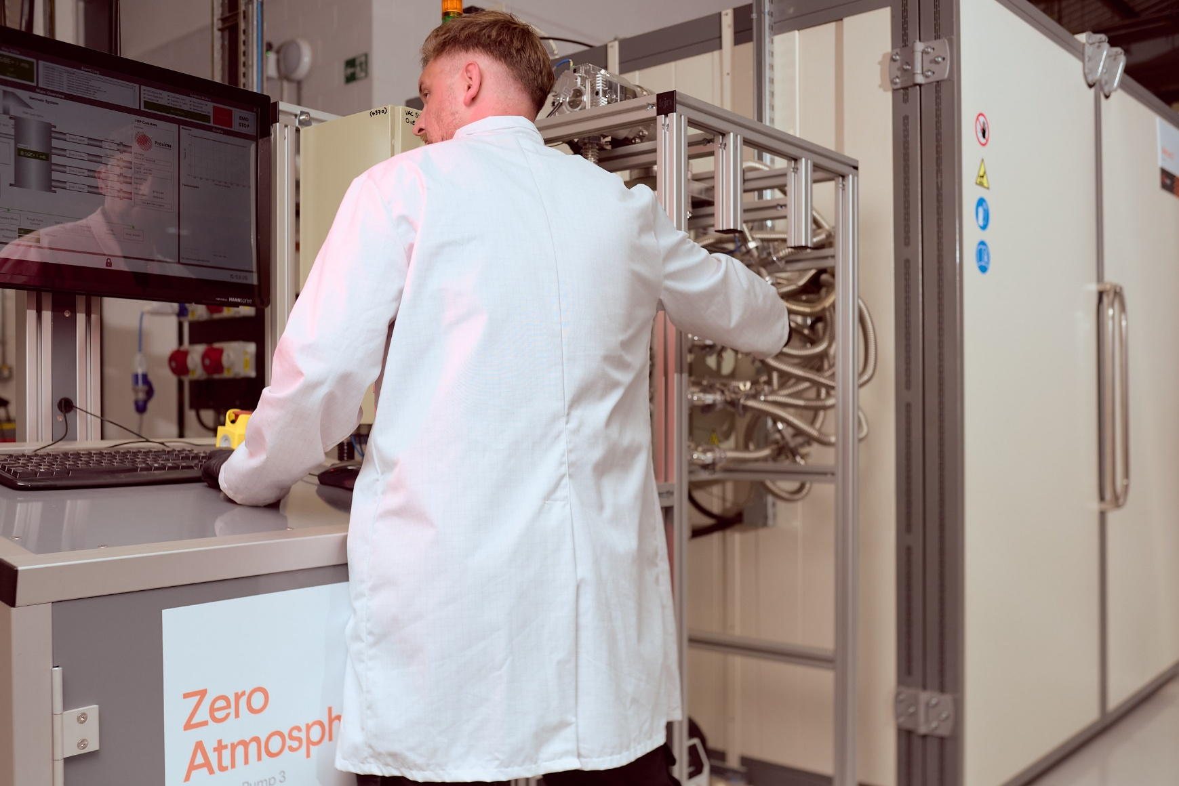
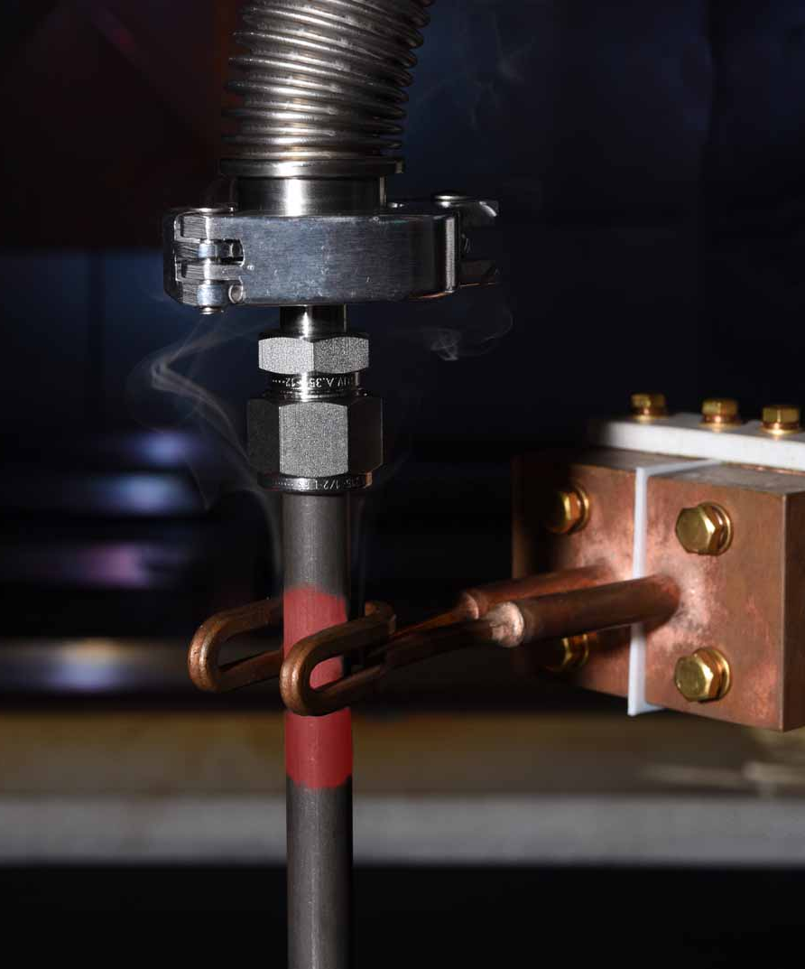
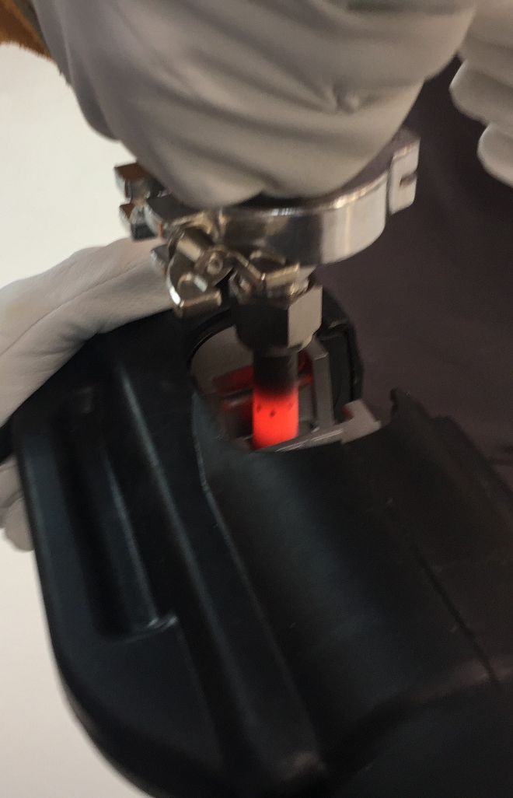
Encapsulation – Bake Out & Vacuum
Capsule with Titanium powder is removed from the filling station and transferred to the bake out oven and vacuum system
Proxima constantly measures the vacuum level and condition of powder
Once the desired levels are achieved, we must ‘hot-crimp’ which totally seals the capsule from the outside environment

Slide 8
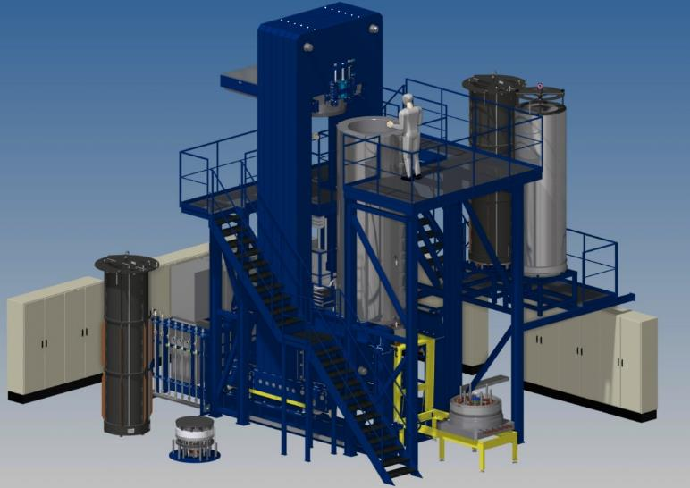
HIP – Hot Isostatic Pressing
Pressure vessel furnace
Combination of heat & pressure
Heat the vessel to a set temperature which the capsule and titanium powder is in a ‘plastic form’
Argon gas is compressed into the hot vessel which creates gas expansion
This powerful gas expansion forces/squishes/consolidates the capsule into the designed preform shape
Heat and pressure is removed – leaving a consolidated ‘preform’
The capsule shrinks between 8% & 15% between the start and finish of the HIP process
Courtesy of EPSI

Slide 9
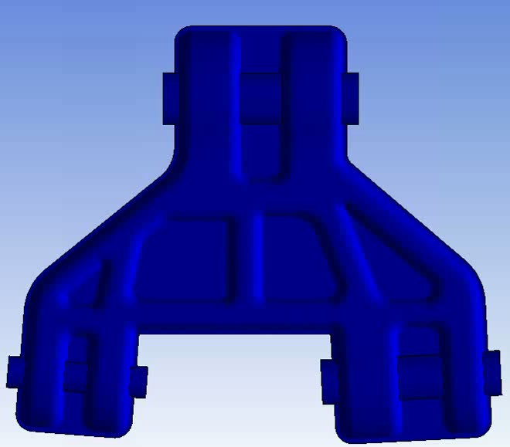
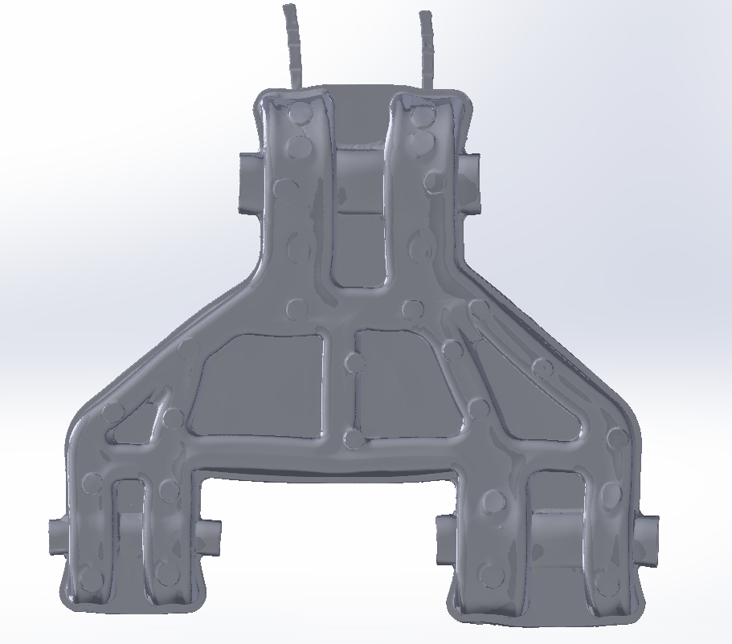
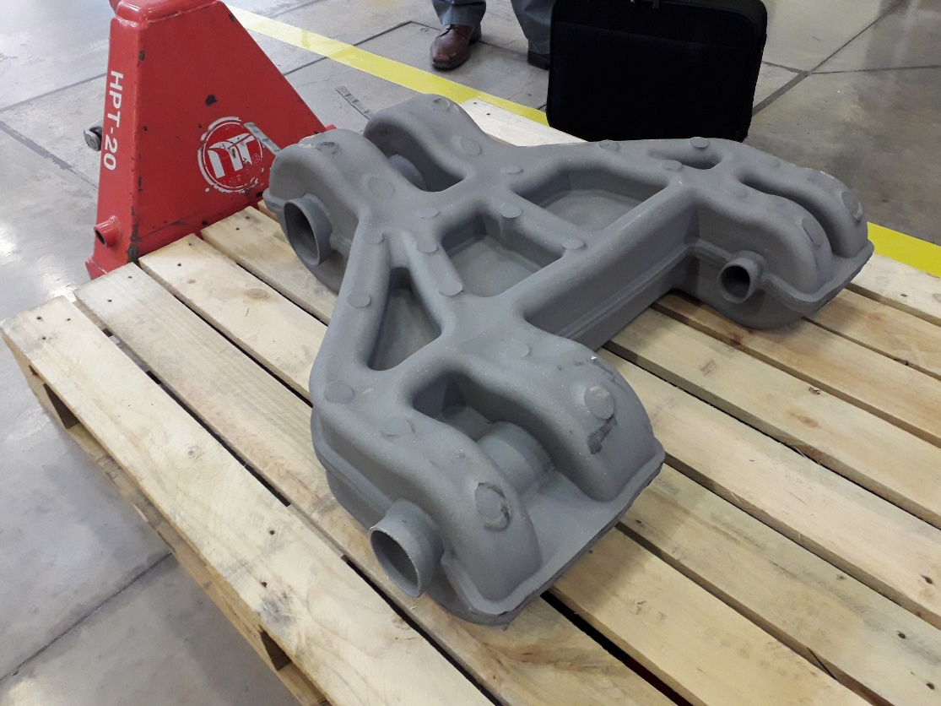
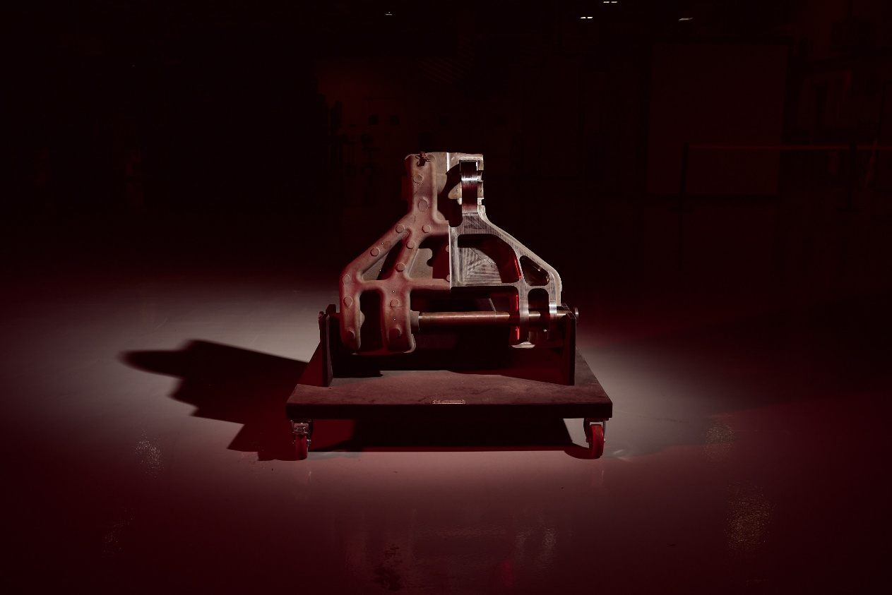
Encapsulation – Post Simulation Verification of Shape
Deformation Prediction
Scan Data Post-HIP
Out of the HIP
Semi-machined Demonstrator
Internal Circulation and Distribution Only

Slide 10
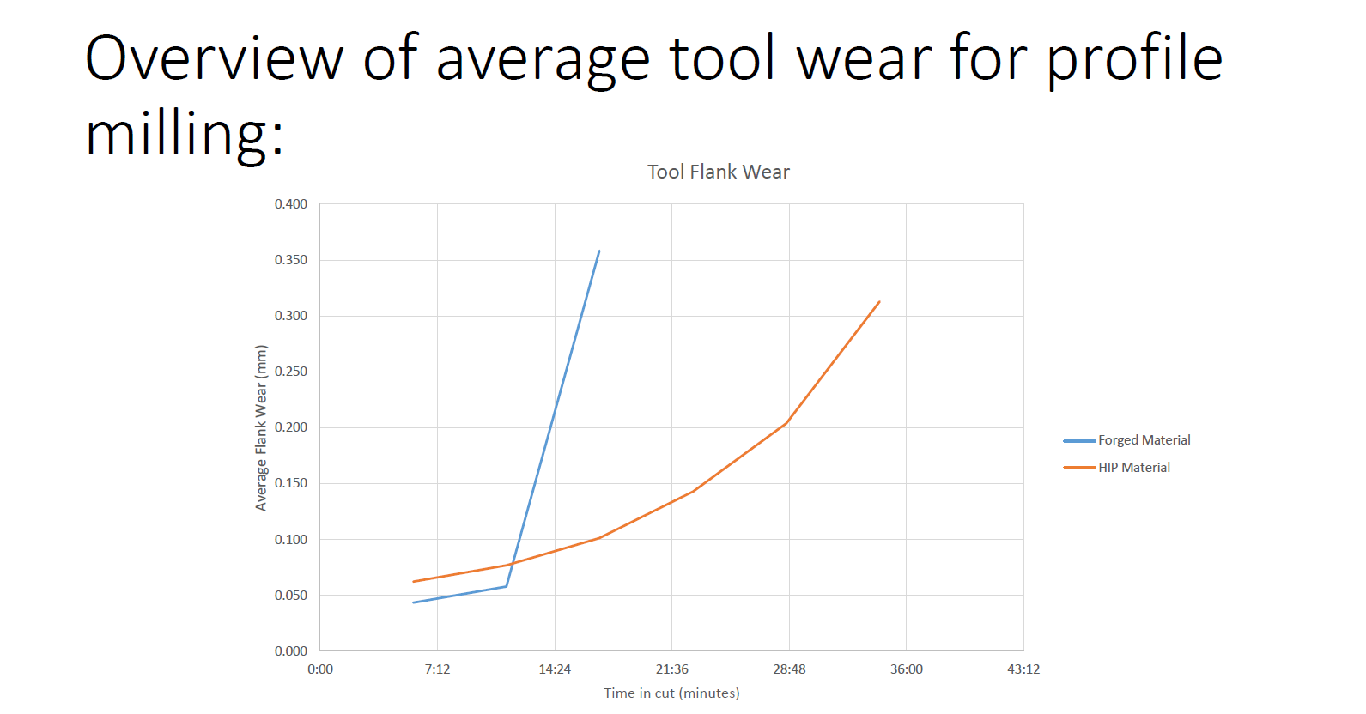
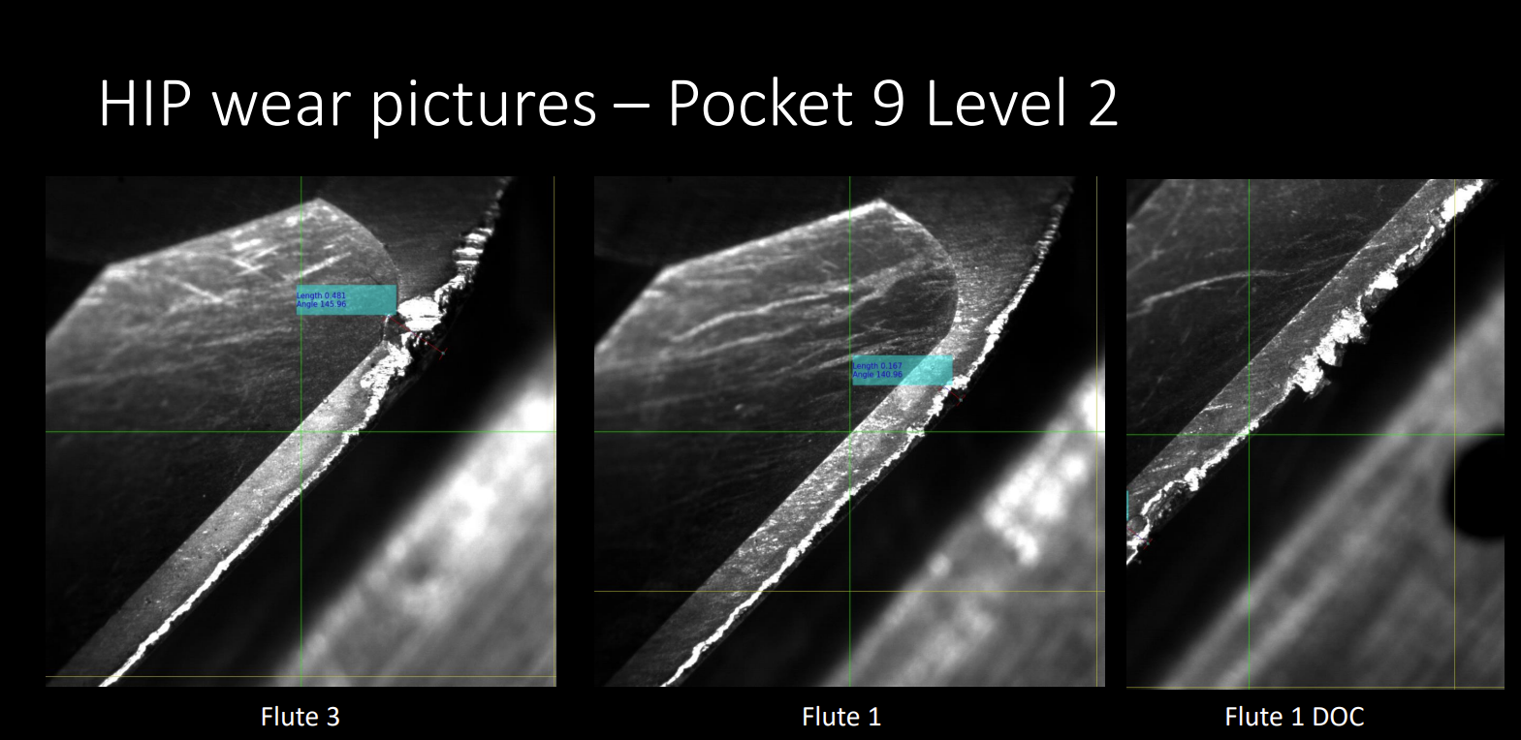
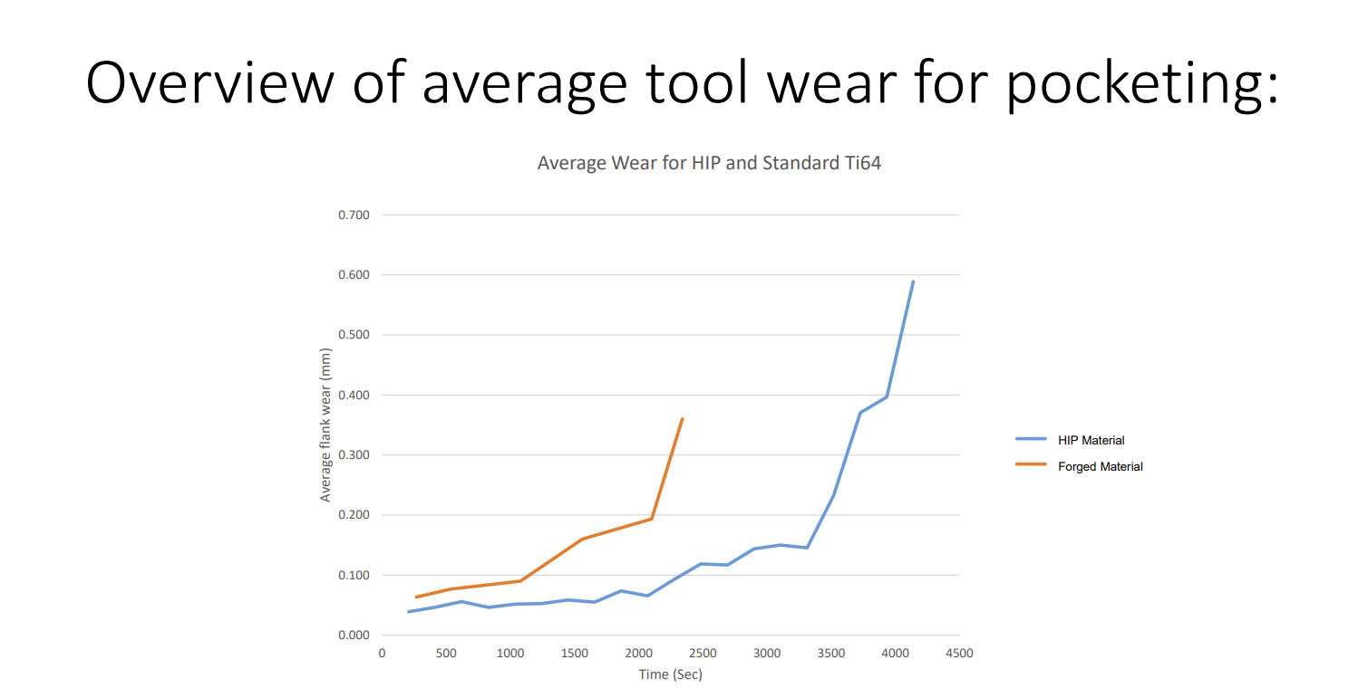
CNC Machining Savings - Carbide Cost Reduction 60% Consumable Wear
Independent report created and available upon request
Baseline approved by Boeing Commercial Aircraft & Advanced Machining Research Centre (AMRC)
Reduced consumable wear due to isotropic structure
HIP material survived 9 milling pockets compared to 3 milling pockets with forging material

Slide 11
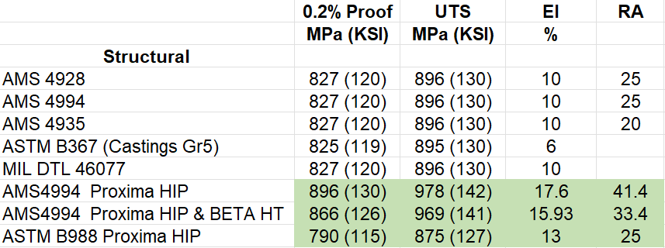
Mechanical Properties – Titanium Parts
PM-HIP national specifications available
Ability to work with your design allowable teams
Fatigue data available upon request too
This is not a future technology – it is available now

Slide 12
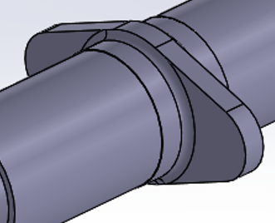
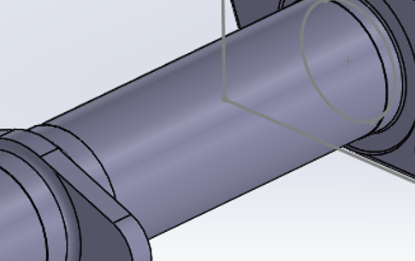
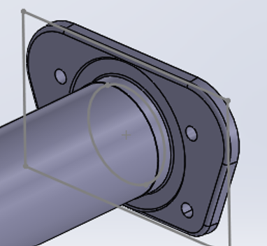
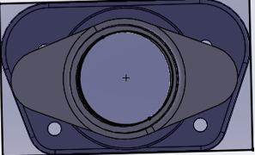
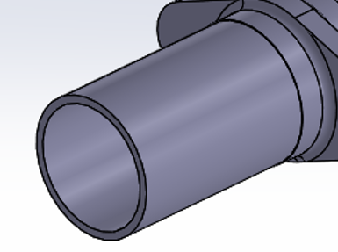


Applications – Case Study Titanium Primary Structure – Jigsaw Puzzle
4
1
6
5
2
7
3

Slide 13
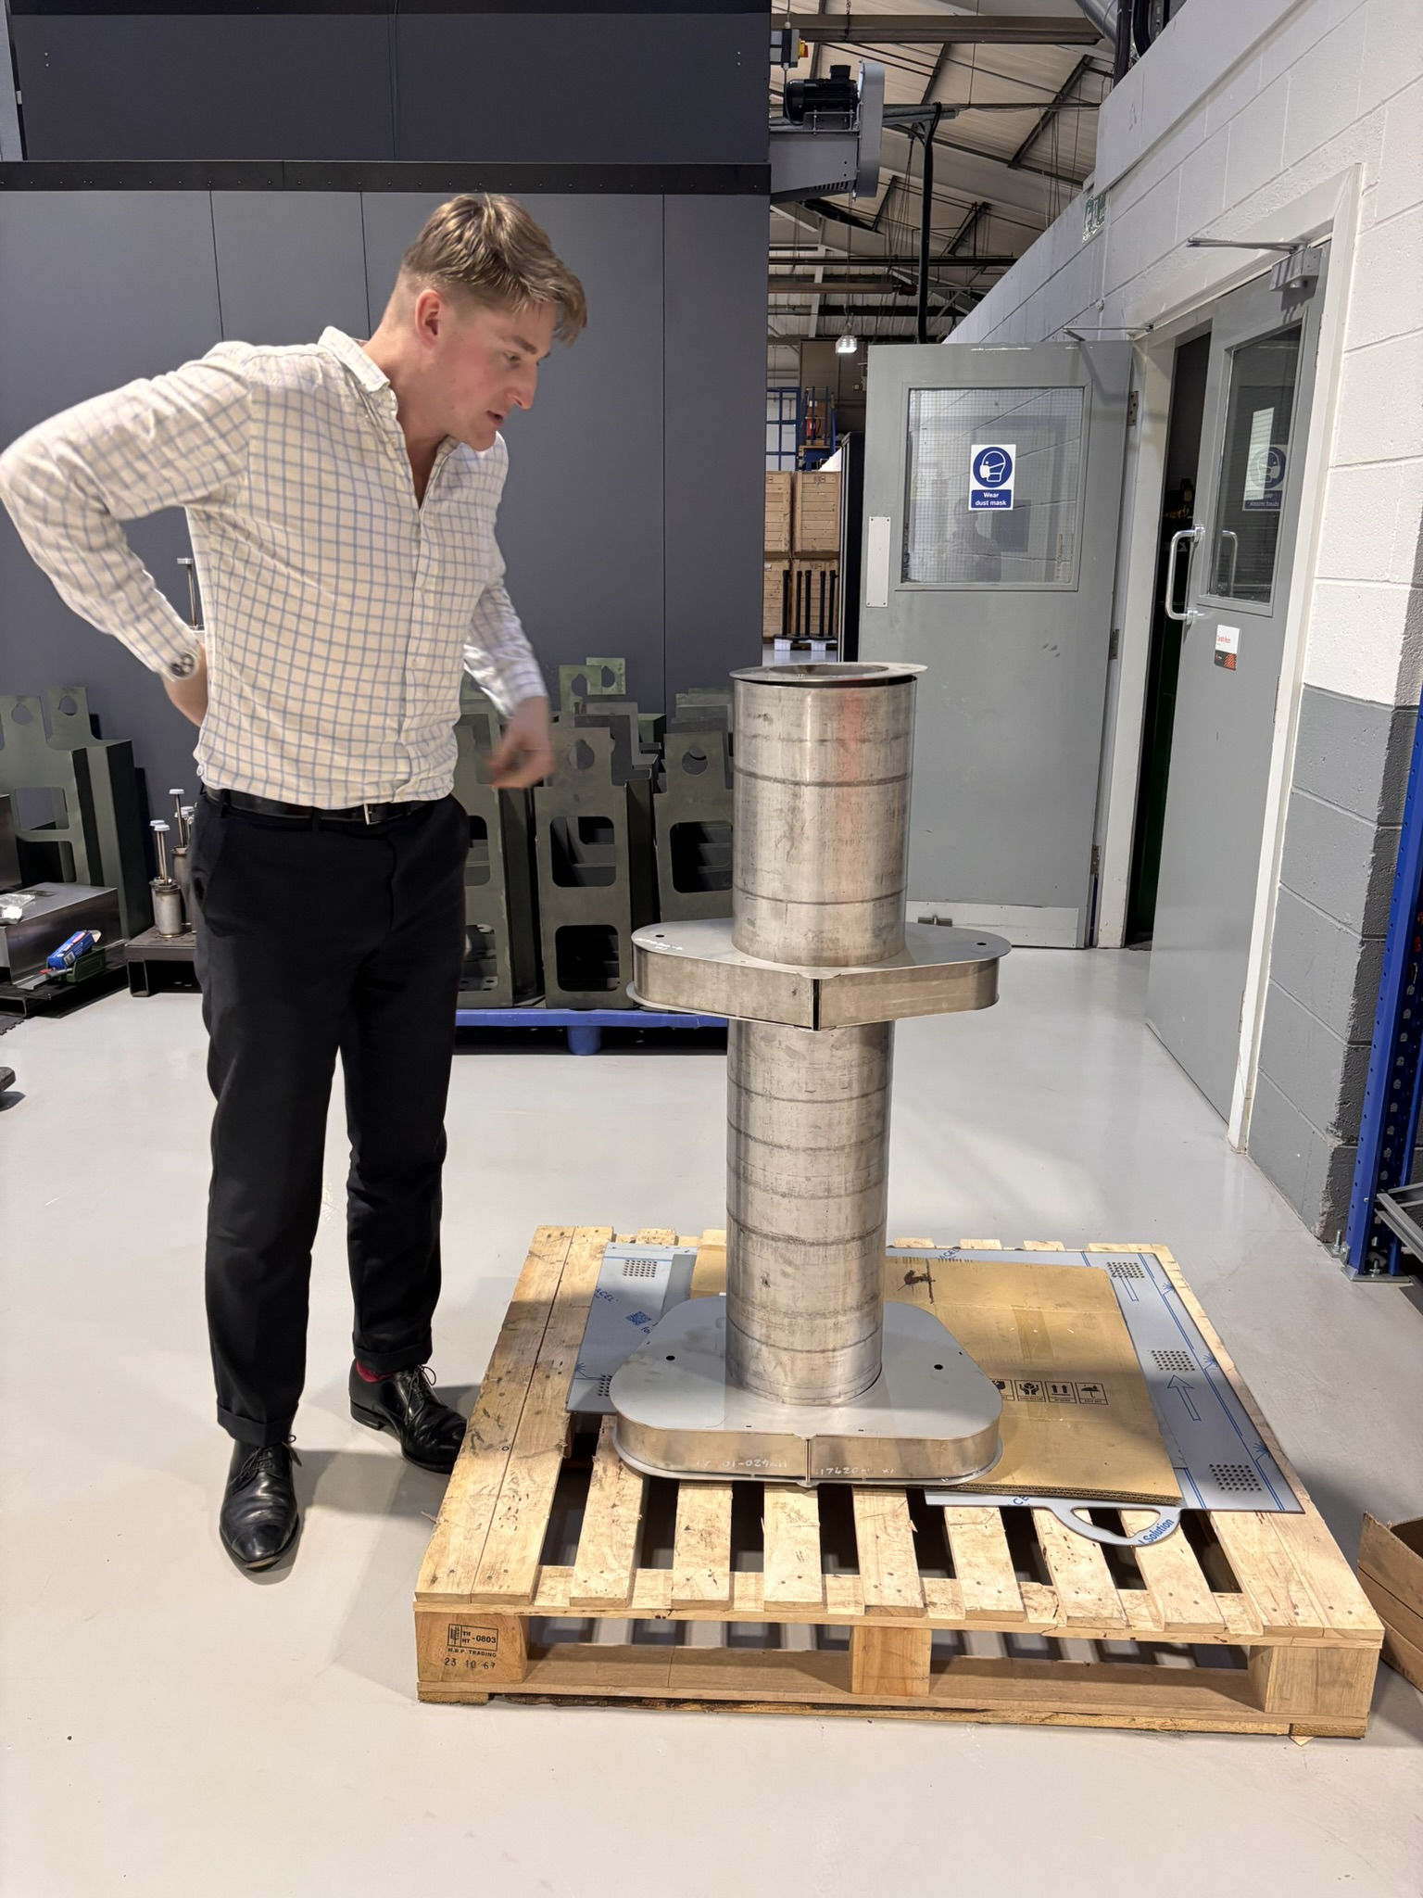
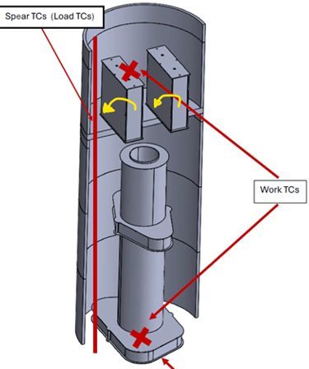
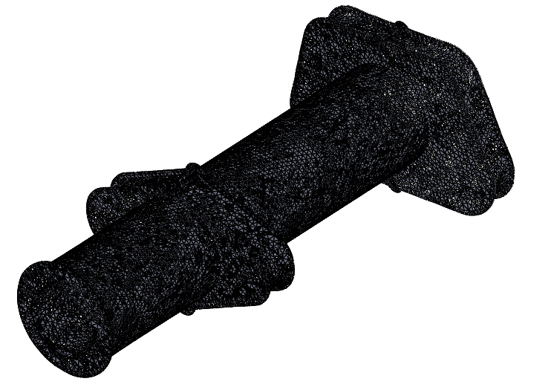
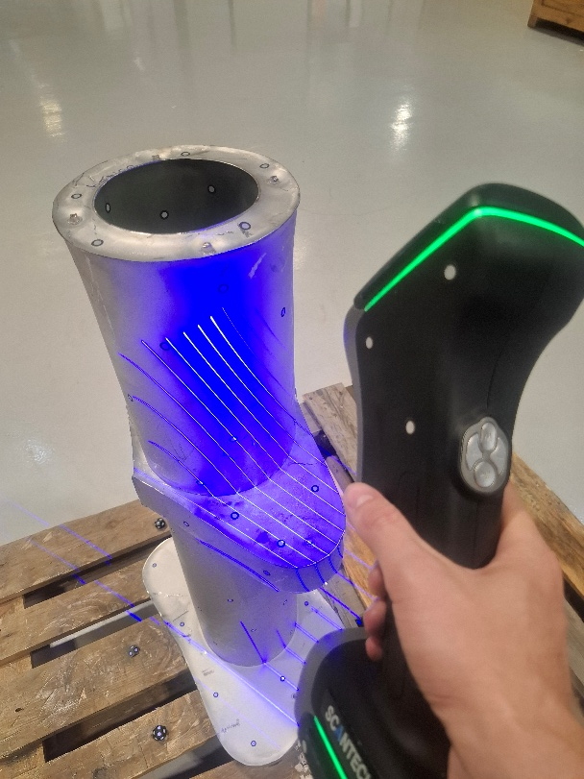
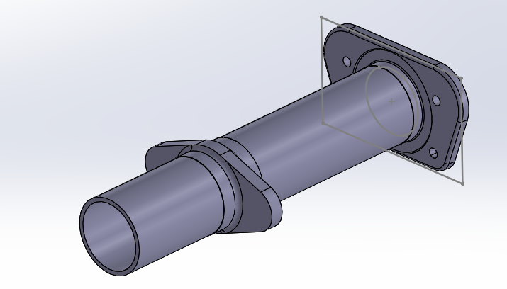
Applications – Case Study – Single Piece Unit – remove welding, 7 parts to 1, collapsed lead-time, easier inventory and no more forgings or extrusions – Designers beware!

Slide 14
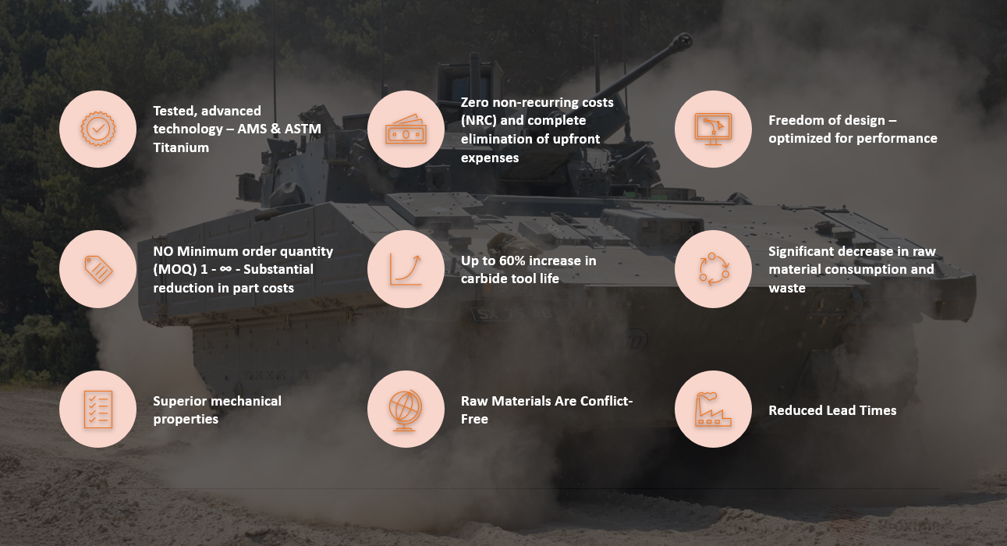
Summary Information & Thank You from the UK

